Slide 1

Distributed messaging
Apache Kafka
Junio - 2021

Slide 2
Summary
Apache Kafka. Basics
Comparative Kafka vs RabbitMQ
Apache Kafka. Demo
Bibliography

Slide 3

1. Basics
Apache Kafka is a distributed messaging system (PUB-SUB pattern)
It was created by Linkedin. Written in Scala.
Uses: in event-driven architecture, real-time streaming, real-time analytics…
Goals: high throughput, horizontal scalability, reliability, loosely coupled, durability.

Slide 4
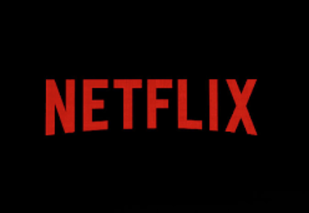


Real use-cases
Netflix uses Kafka to apply recommendations in real-time.
Uber uses Kafka to manage taxis, users, trips, and compute prices in real-time.
Linkedin uses Kafka to prevent spam, for recommendations…

Slide 5
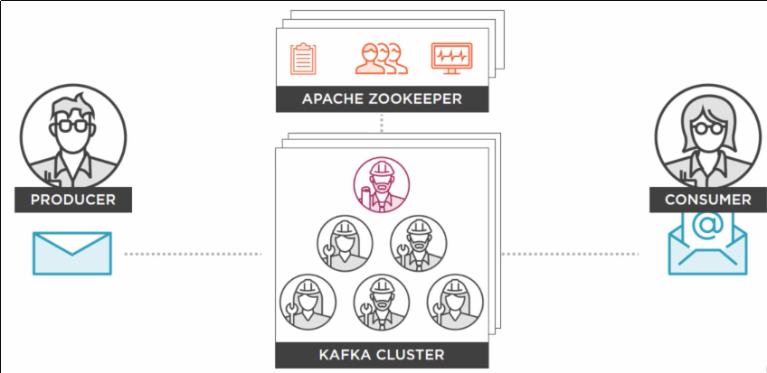
Architecture
Main components: Zookeeper, brokers, clusters, topics, partitions, producers, consumers

Slide 6
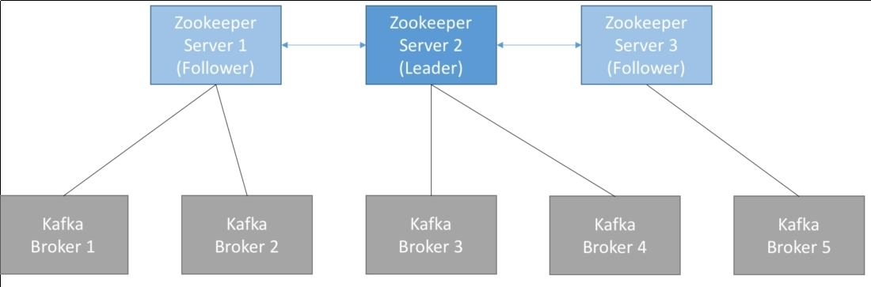
Apache Zookeeper
Apache Zookeeper: distributed coordinator of brokers (odd number 3 5, 7…).

Slide 7
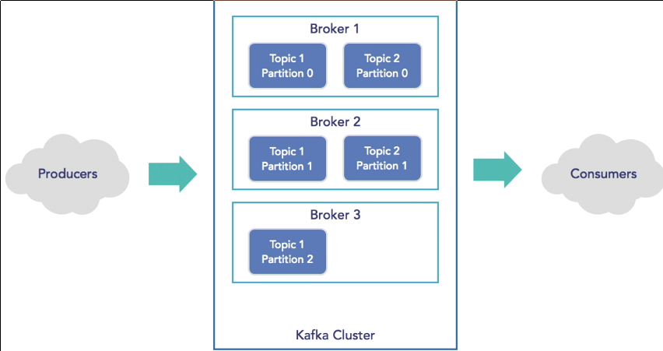
Brokers
Broker is a server, a node where one or various topics are assigned (various brokers form a cluster)

Slide 8
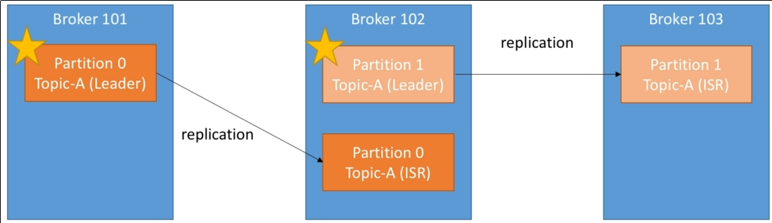
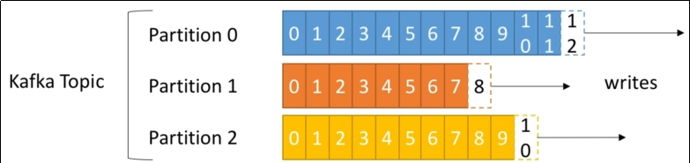
Topics
Immutable messages (only created, not updated), grouped by topic.
Split into partitions, for load-balancing.
Replication-factor (of partitions), for resilience (It must be <= numOfBrokers)
Retention: by default, one week.

Slide 9
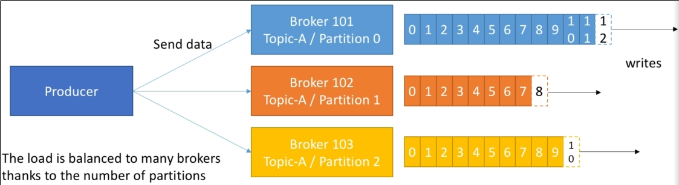
Producers
Producers write data to topics.
Acks (0, 1, 2): depending of the value, the Producer waits for acknowledgment or not (more or less risk of data loss)

Slide 10
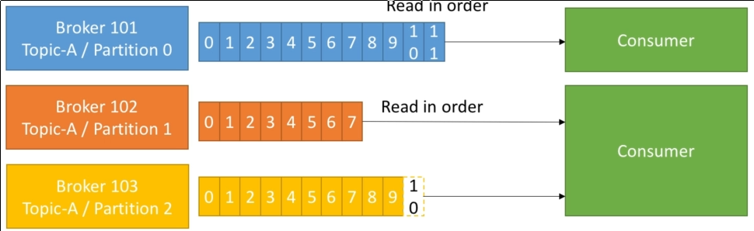
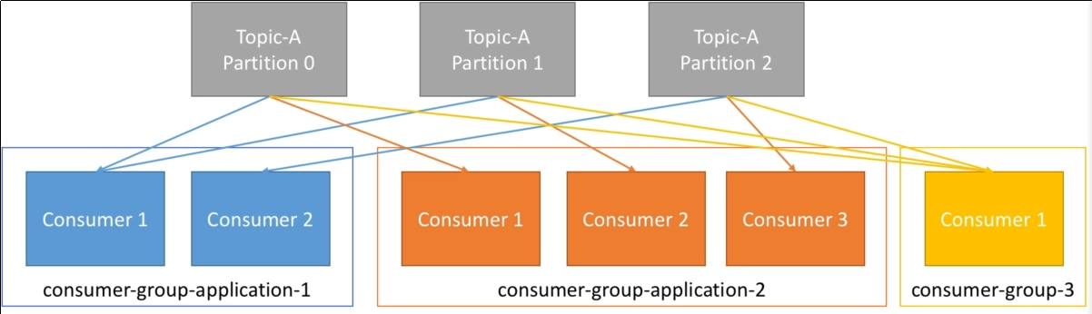
Consumers
Consumers read data from a topic (from the offset)
The Consumer keeps track of the consumed messages through an offset.
Group of consumers, for load-balancing

Slide 11
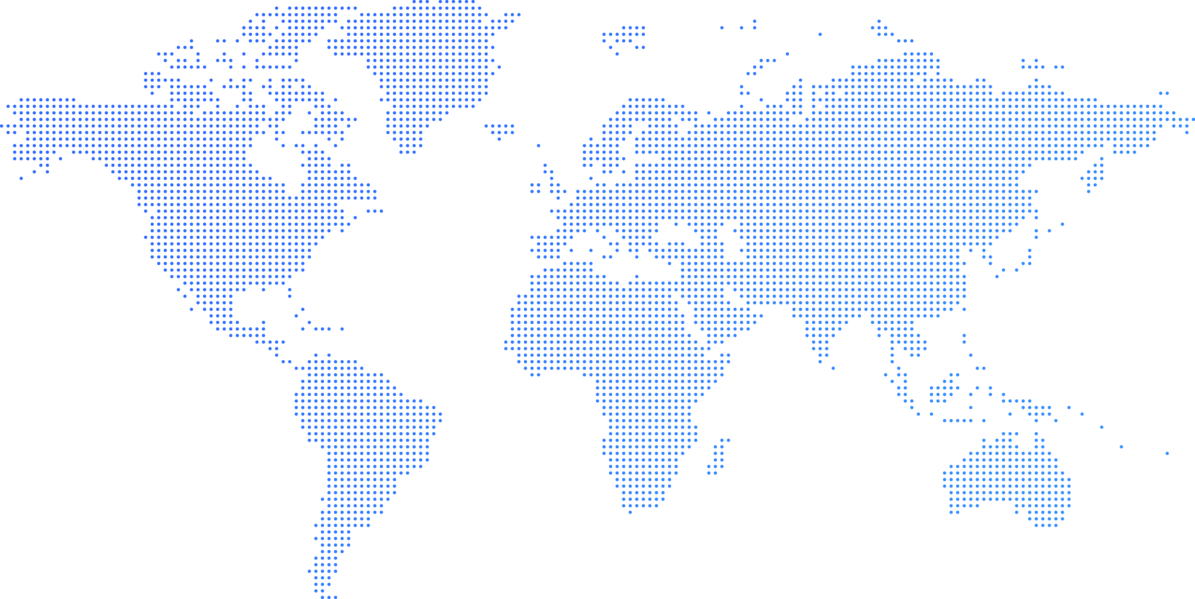
2. RabbitMQ vs Kafka
B
RabbitMQ
Kafka
Description
Year
Written
Protocol
Streaming
Message handling
Open source distributed message broker
2007
Erlang
AMQP, MQTT, STOMP
with Spring-Cloud-Data-Flow
Message removed when acked
Distributed event streaming platform
2011
Scala
Custom protocol
Kafka-Streaming.
Persistent: retention period

Slide 12
RabbitMQ vs Kafka (II)
B
RabbitMQ
Kafka
Routing
Message priority
Ecosystem
Scaling broker
Big data
License
Complex (direct, topic, fanout, header)
Yes
Only message-broker
Vertical
---
Public Mozilla (AMQP protocol interchangeable)
Simple (consumer groups)
No
Core, Streams, Connect, REST, Schema
Horizontal
Large volumes of messages (BIG-DATA)
Open-source (in the future? Custom protocol)

Slide 13
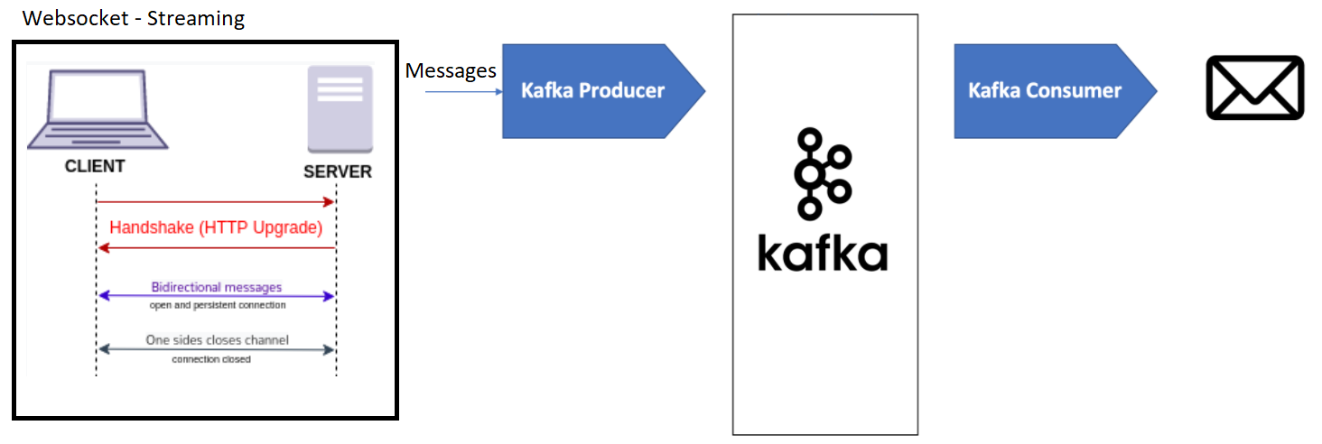
3. Demo
Collection layer: Streaming pattern – Websocket protocol
(ws://stream.meetup.com/2/rsvps)
Queuing layer: Pub/Sub pattern (Producer / Consumer)

Slide 14
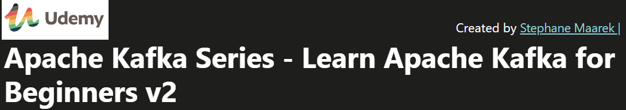
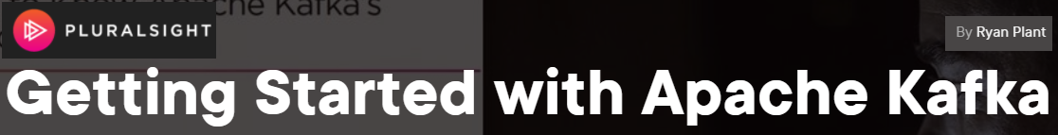

4. Bibliography
https://kafka.apache.org
https://cognizant.udemy.com/course/apache-kafka/
https://www.pluralsight.com/courses/apache-kafka-getting-started
Apache Kafka Quick Start Guide (Raúl Estrada)

Slide 15
Thank you
Reference-Architecture project
By Hugo Mozo

Slide 16


